Slide 1
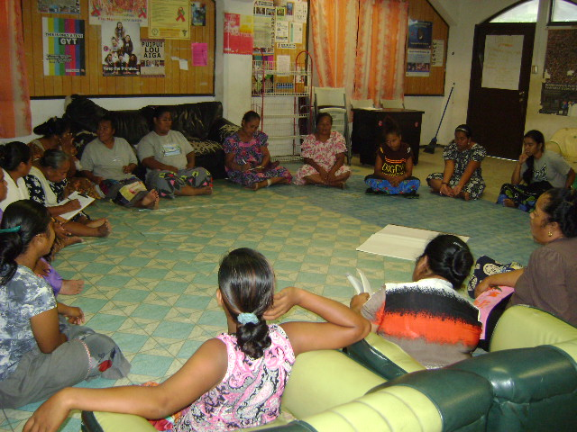
SS Nepukos Beach Side Young and Older Women

Slide 2
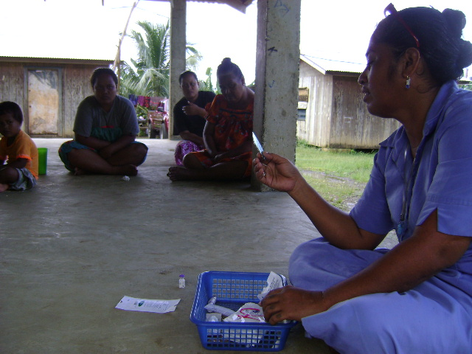
Family Planning Nurse (SS Contraceptive Session)

Slide 3
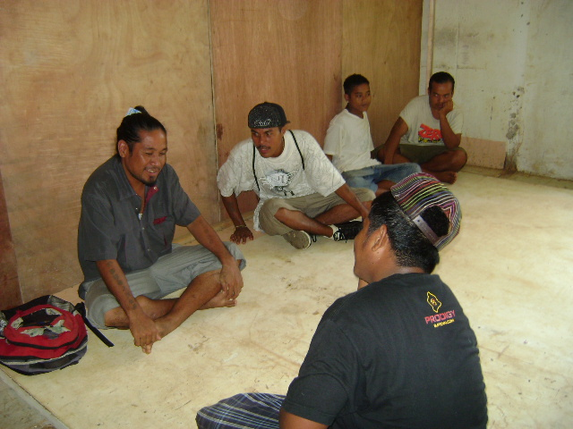
SS Male Skit/Roll play on Gender Issues

Slide 4
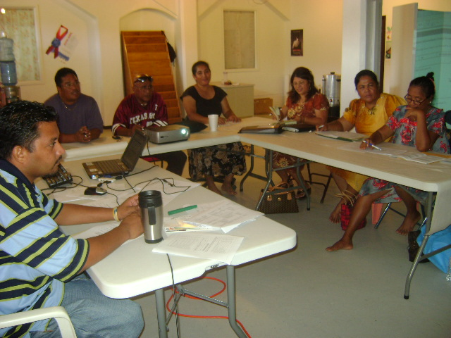
Community Planning Group and SS Village Leaders discussing SS Implementation Issues

